Slide 1
KIARA & SEAN’S WEDDING
MAY 25TH, 2026
80 GUESTS
SHANGRI-LA, PARIS
WEDDING MOOD BOARD

Slide 2
SIGNS

Slide 3
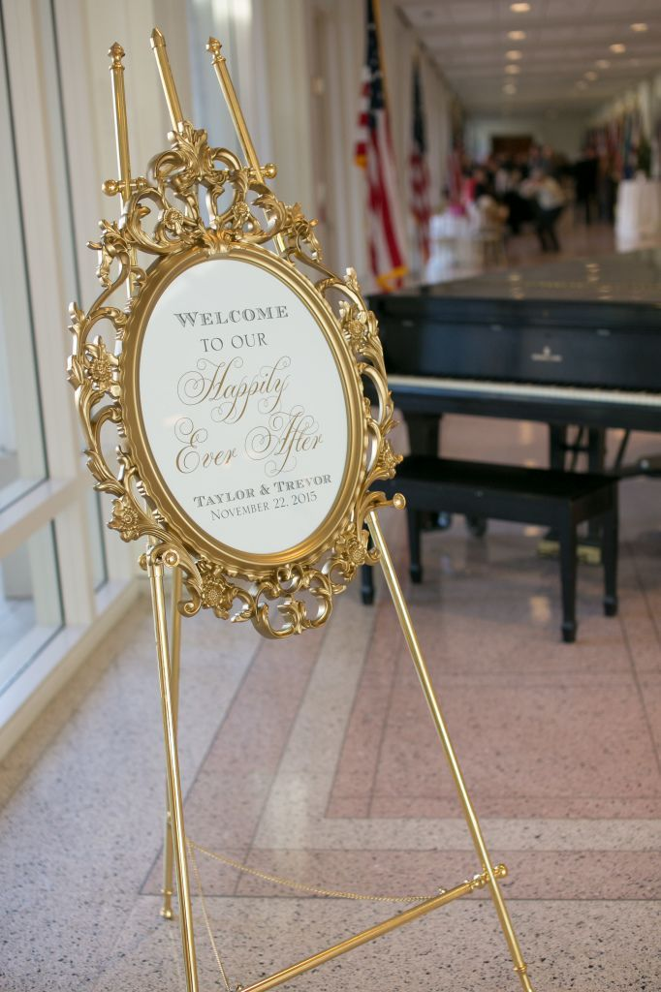
Welcome Sign & Décor
A Baroque-style gold mirror will showcase the bride and groom’s names in luminous gold script, paired with the wedding date in refined dark brown typography, exuding sophistication and timeless elegance
The gold frame will be a distinct variation from the reference image, providing a bespoke and sophisticated touch while preserving the overall elegance of the design

Slide 4
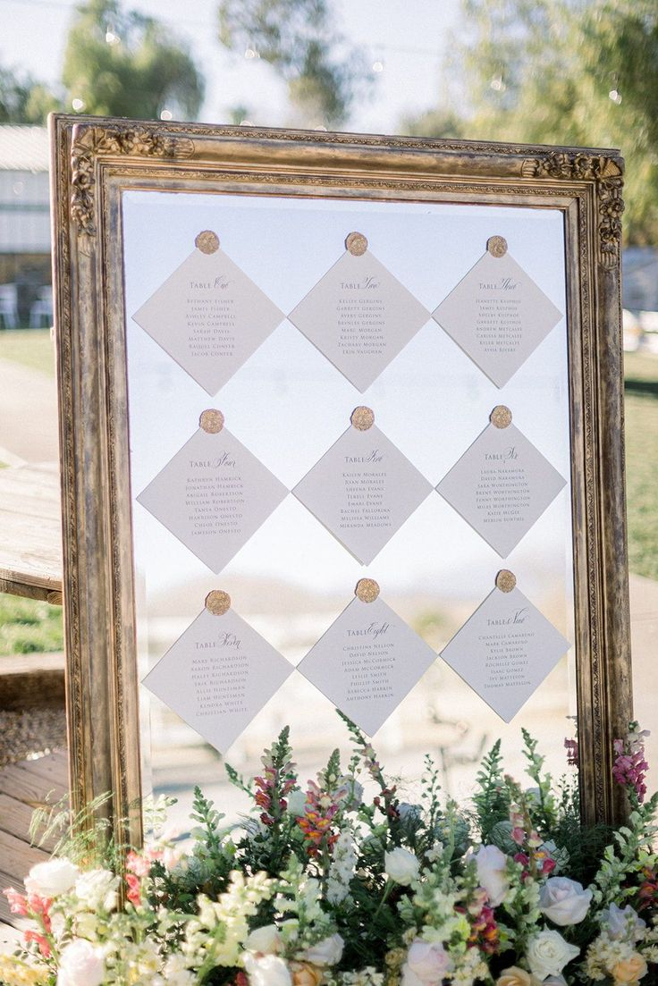
Seating Chart
A large rectangular gold-framed mirror will display the seating chart, featuring wax-sealed, gold-stamped cards elegantly presenting each table number and guests’ names
A medium-sized floral arrangement will be displayed at the base of the seating chart, with décor echoing the reference imagery and styled in harmony with the color palette detailed on slide #2

Slide 5
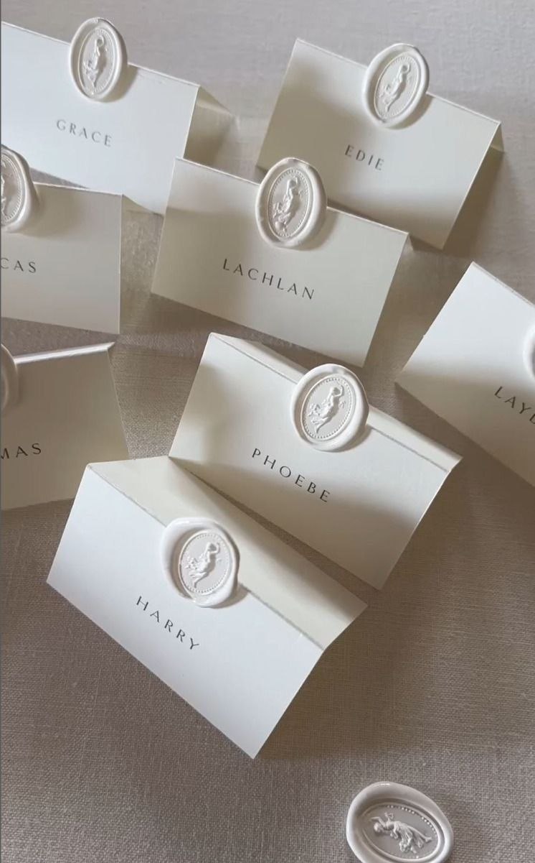
Place Cards
Audrey’s Note:
Please note that place cards are required by the catering staff regardless of round or rectangular tables. For weddings with more than 100 guests, place cards must be placed on each table with assigned seating, showing each guest’s full name, table number, and a meal icon/allergy note to guide the staff.

Slide 6
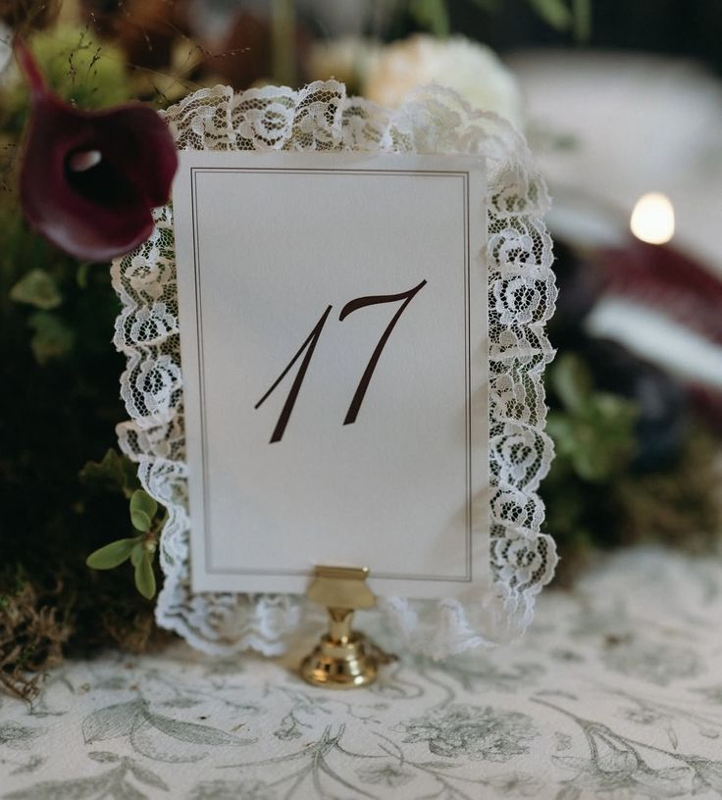
Table numbers
A sophisticated rectangular design, printed on warm white paper and enhanced with delicate lace detailing and elegant script typography, will be gracefully displayed on a gold holder, exuding understated elegance

Slide 7
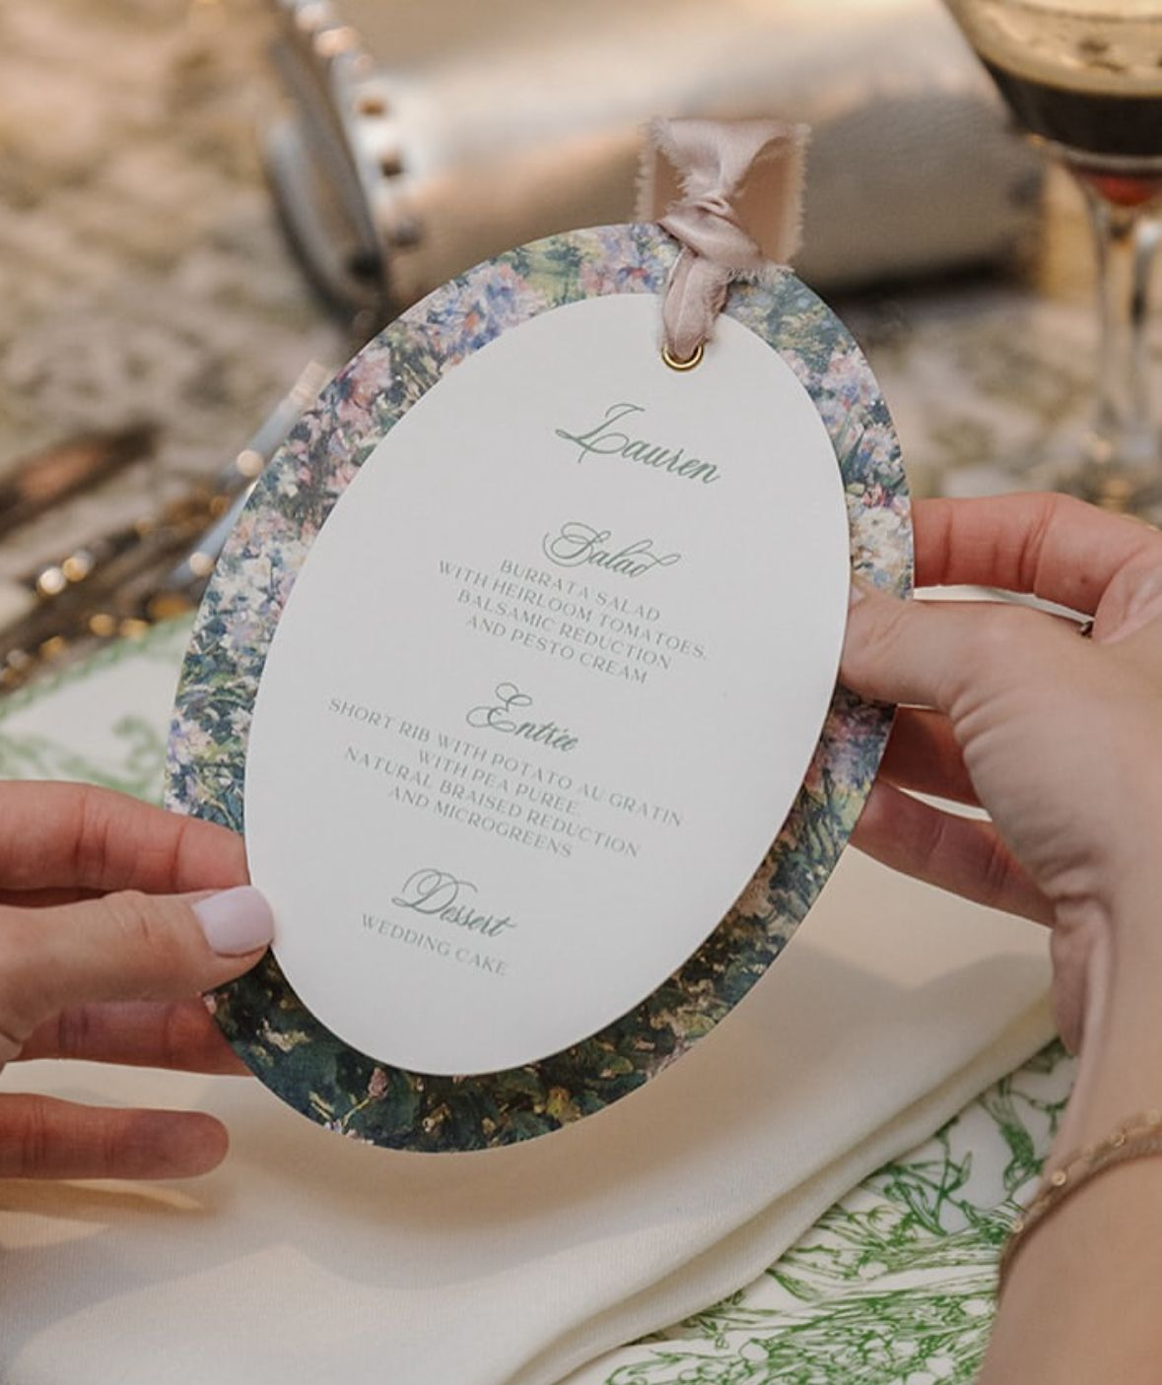
Menus
An oval-format menu, adorned with a delicate light background card beneath and featuring elegant dark green script typography at its center, accented with a light pink ribbon, exuding refined and harmonious sophistication
Audrey’s note: For the menu the Bride would like something with a more simple background paper vs the busy floral design.

Slide 8
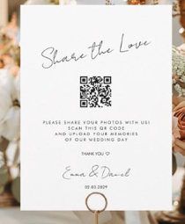
QR Code Sign
Simple aesthetic as picture

Slide 9
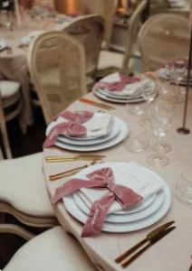
Satin bows on plates
as picture – Light Pink color but satin material

Slide 10
NOTES FOR PLANNER AND FLORIST TEAM ONLY (FRENCH):
70 MENUS
70 PLACE CARDS AVEC WAX SEAL NON PERSONNALISÉ, MAIS SIMILAIRE A LA PHOTO
7 NUMEROS DE TABLE + LEUR SUPPORTS
7 CARTES TABLES POUR LE MIRROIR + WAX SEAL NON PERSONNALISÉ
7 QR CODE DESIGN
70 NOEUDS EN SATIN ROSE A DISPOSER DANS LES ASSIETTES
1 WELCOME SIGN AVEC UN MIRROIR DORÉ SIMILAIRE + CHEVALET DORE SIMILAIRE

